Slide 1
SQCDP data pipeline
Adrián Brey

Slide 2
Introduction
Context
Technology constraints
Solution
Reinterpretation with modern ETL tool

Slide 3
Context
Development of monitoring tool for Spares and Repairs supply chain for Airbus DS, with over 35k open purchase orders at any given time.
The objective is to calculate several KPI’s with some level of granularity, so we can zoom into the details at the department, supplier and even buyer level.
Each purchase order is tied to is linked to a great number of facts, metrics and sources of information: quality, export regulations, contracts, on time delivery…
Multiple sources of data, only accessible through manual SAP extractions in xlsx format.
Traditional approach is to have VB macros match the files using VLOOKUP’s.

Slide 4
Technology constraints
Only Excel and MS Access available. No ORM, no modern language features.
Fastest approach is to model data into a database and calculate KPI’s using SQL queries.
VB provides recordsets to connect with databases, to write into a table we must open a recordset to each parent table, retrieve the value of the foreign key and write to the child table.
Soon this becomes unmanageable. This is only one of many projects were we needed heavy data processing.

Slide 5
Solution
Develop a tool that automatically detects foreign key relationship and fill the appropriate data.
Excel can be queried using SQL.
This soon develops into an ETL development tool of sorts, that allows to create complex pipelines without coding.
Pipeline definitions are stored as XML files.
As a result development and report generation times are greatly reduced, being able to keep track of over 150 KPI’s for this project alone.

Slide 6
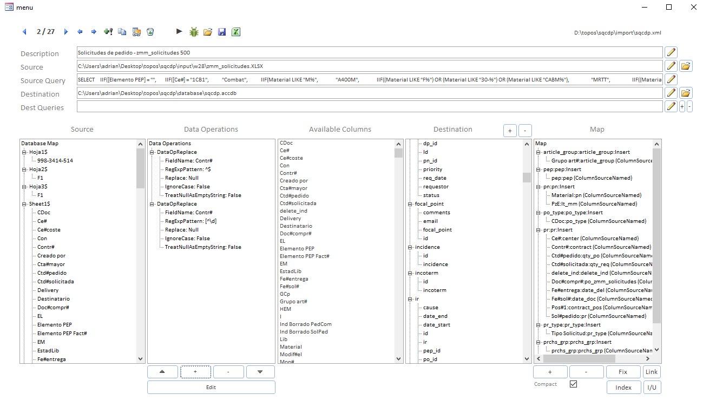
Solution

Slide 7
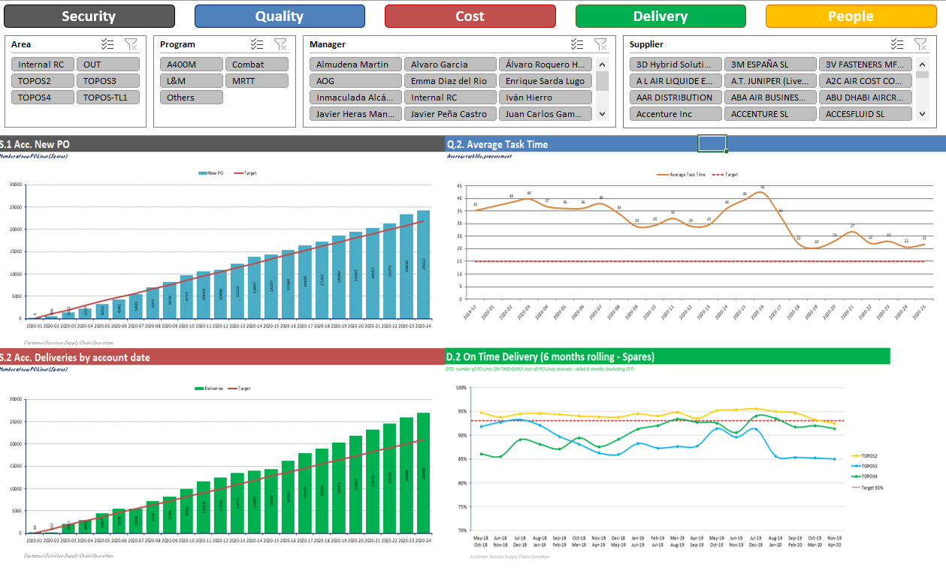
Solution

Slide 8
Reinterpretation with modern ETL TOOL – Key concepts
Only a small subset of this project has been replicated.
The objective is to process some of the raw Purchase Order and Quality data to provide some KPI’s:
On time delivery rate.
Late deliveries.
Comment rate (comments are input by buyers and must follow some guidelines
Rejections.

Slide 9
Reinterpretation with modern ETL TOOL – Key concepts
Purchase Orders:
Most information comes from a single file of ~35k lines.
It provides information about supplier, expected and actual delivery dates, quantity…
Comment data is compiled from ~50 files, matched against PO’s and the validated.
Validation is done against several regular expressions, and each comment type has a different period of validity.

Slide 10
Reinterpretation with modern ETL TOOL – Key concepts
Quality Notifications:
A quality notification is opened when a fault is detected in a delivery.
The fault can affect only part of a delivery.

Slide 11
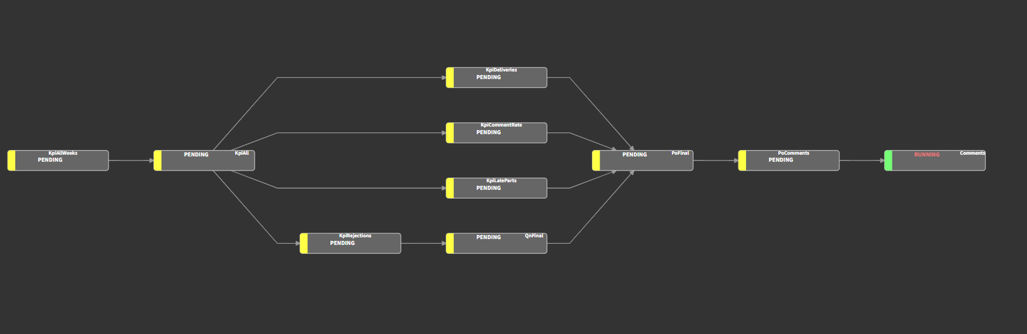

Slide 12
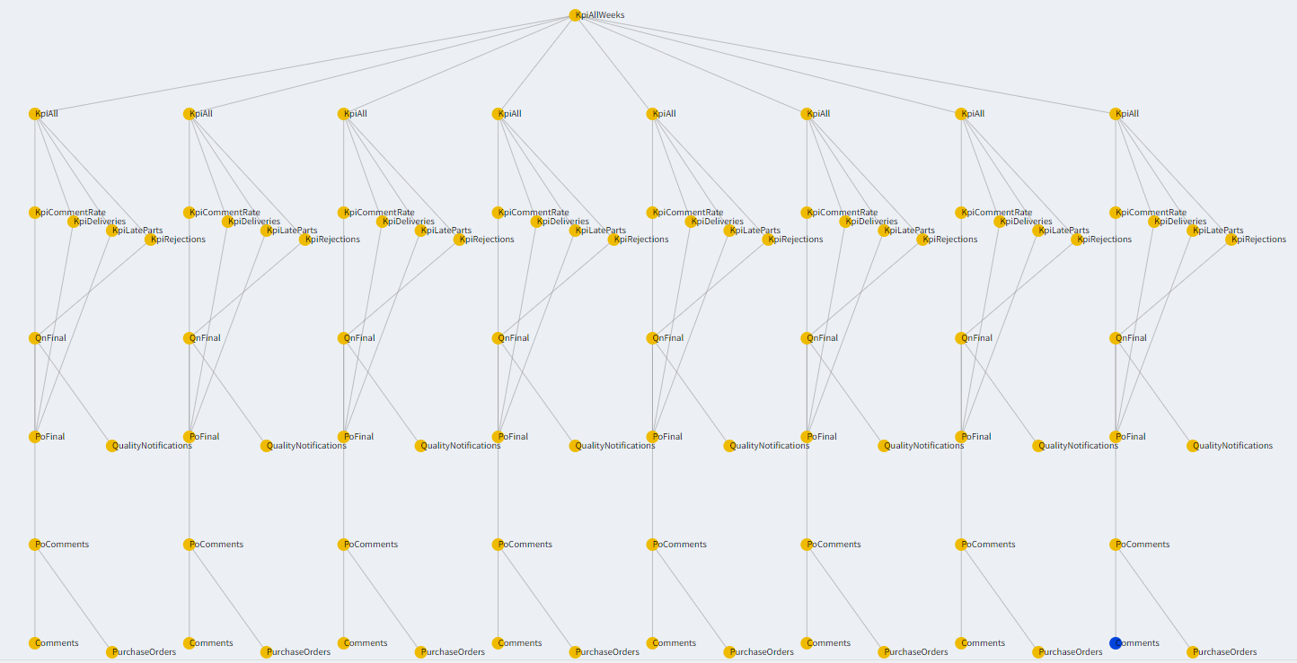

Slide 13
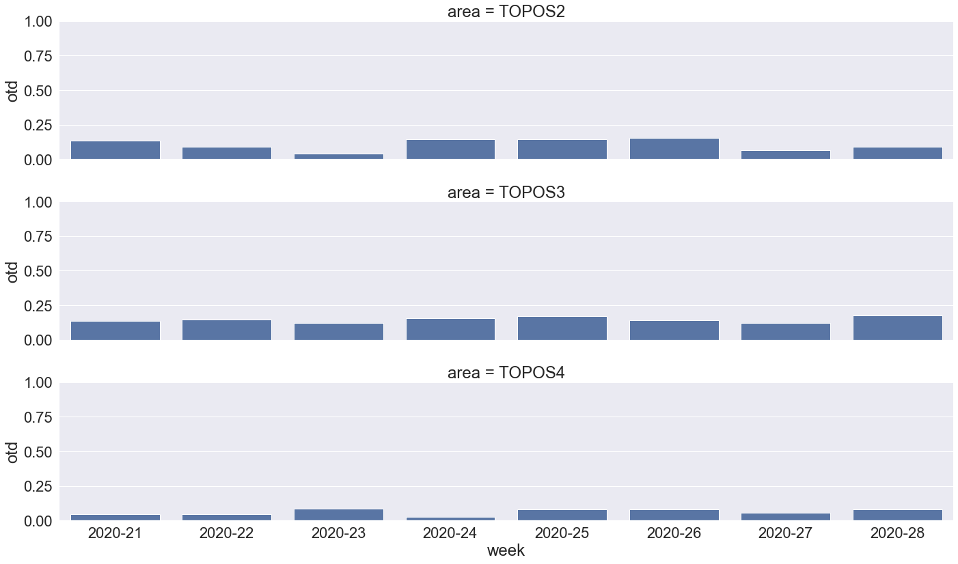

Slide 14
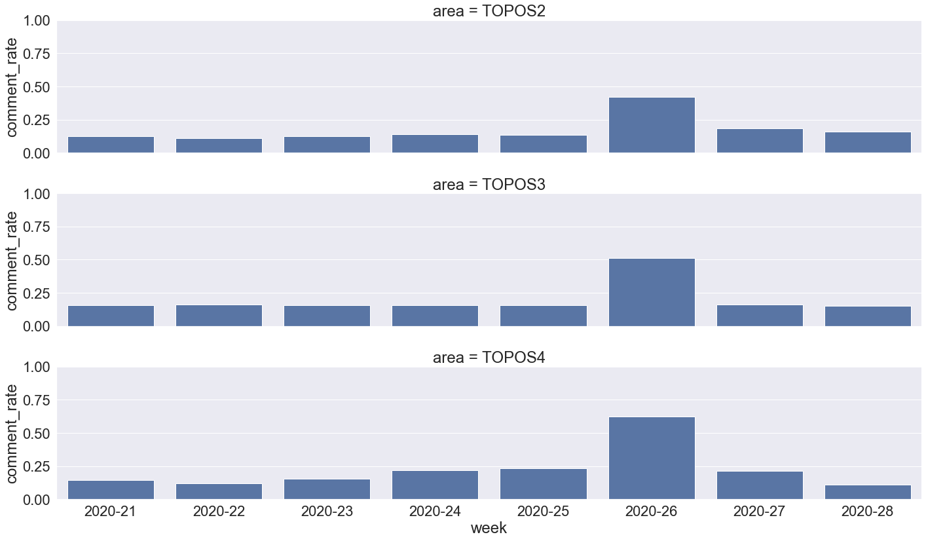

Slide 15
